Slide 1
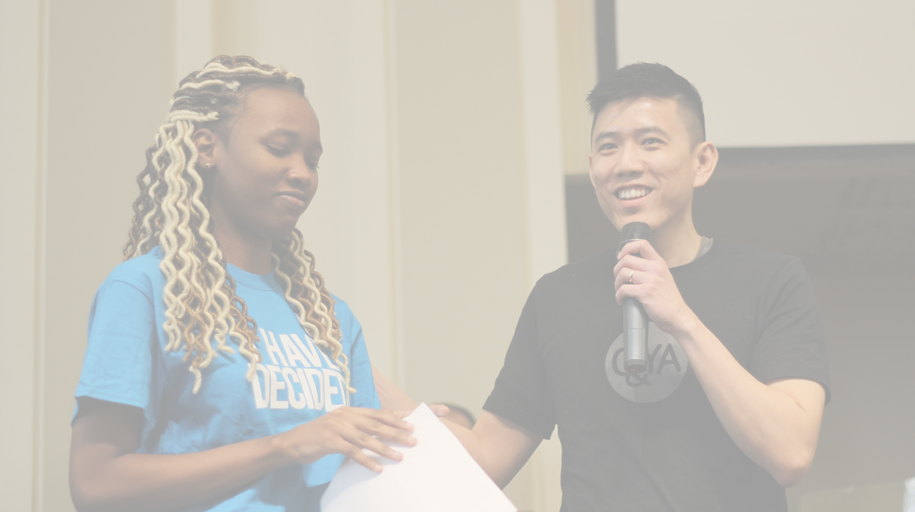
0
Vision
Update
2
8
1

Slide 2
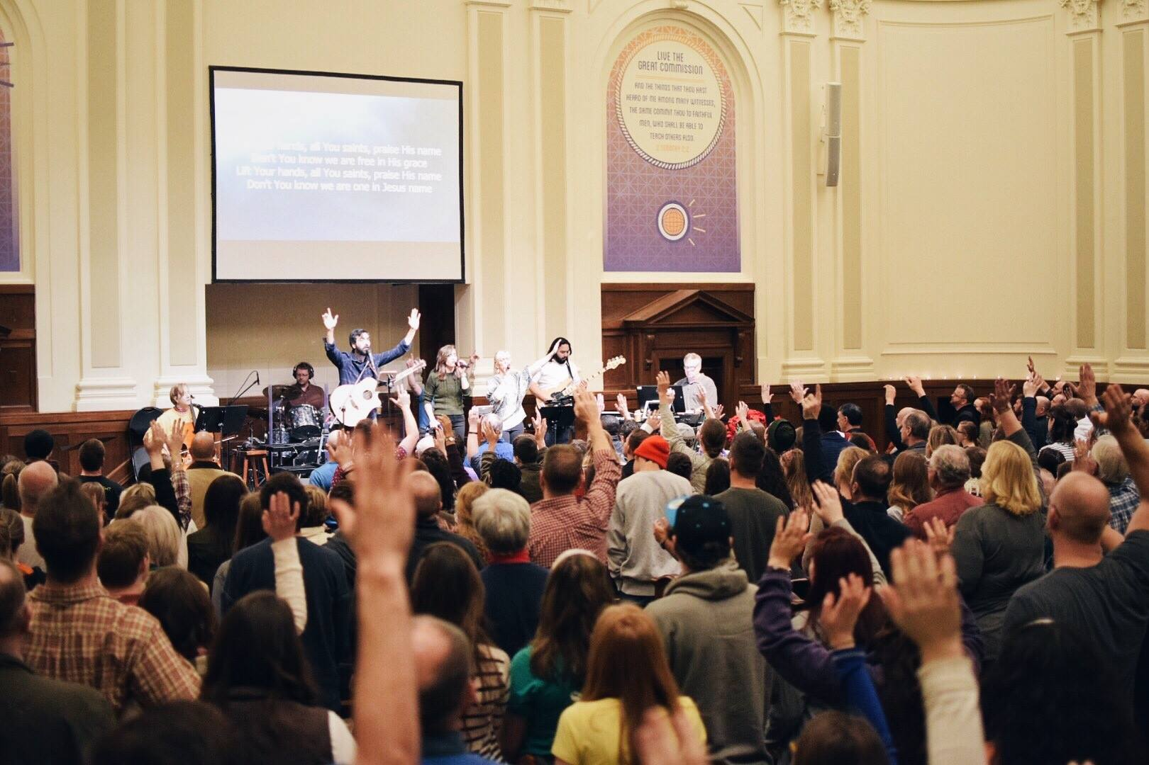
So help us God and by His grace, we will make disciples that will go and do the same from our city’s urban core.
KCBT Midtown

Slide 3
Soul
Winning
Leadership Equipping
Disciple
Making
Sending
Church

Slide 4
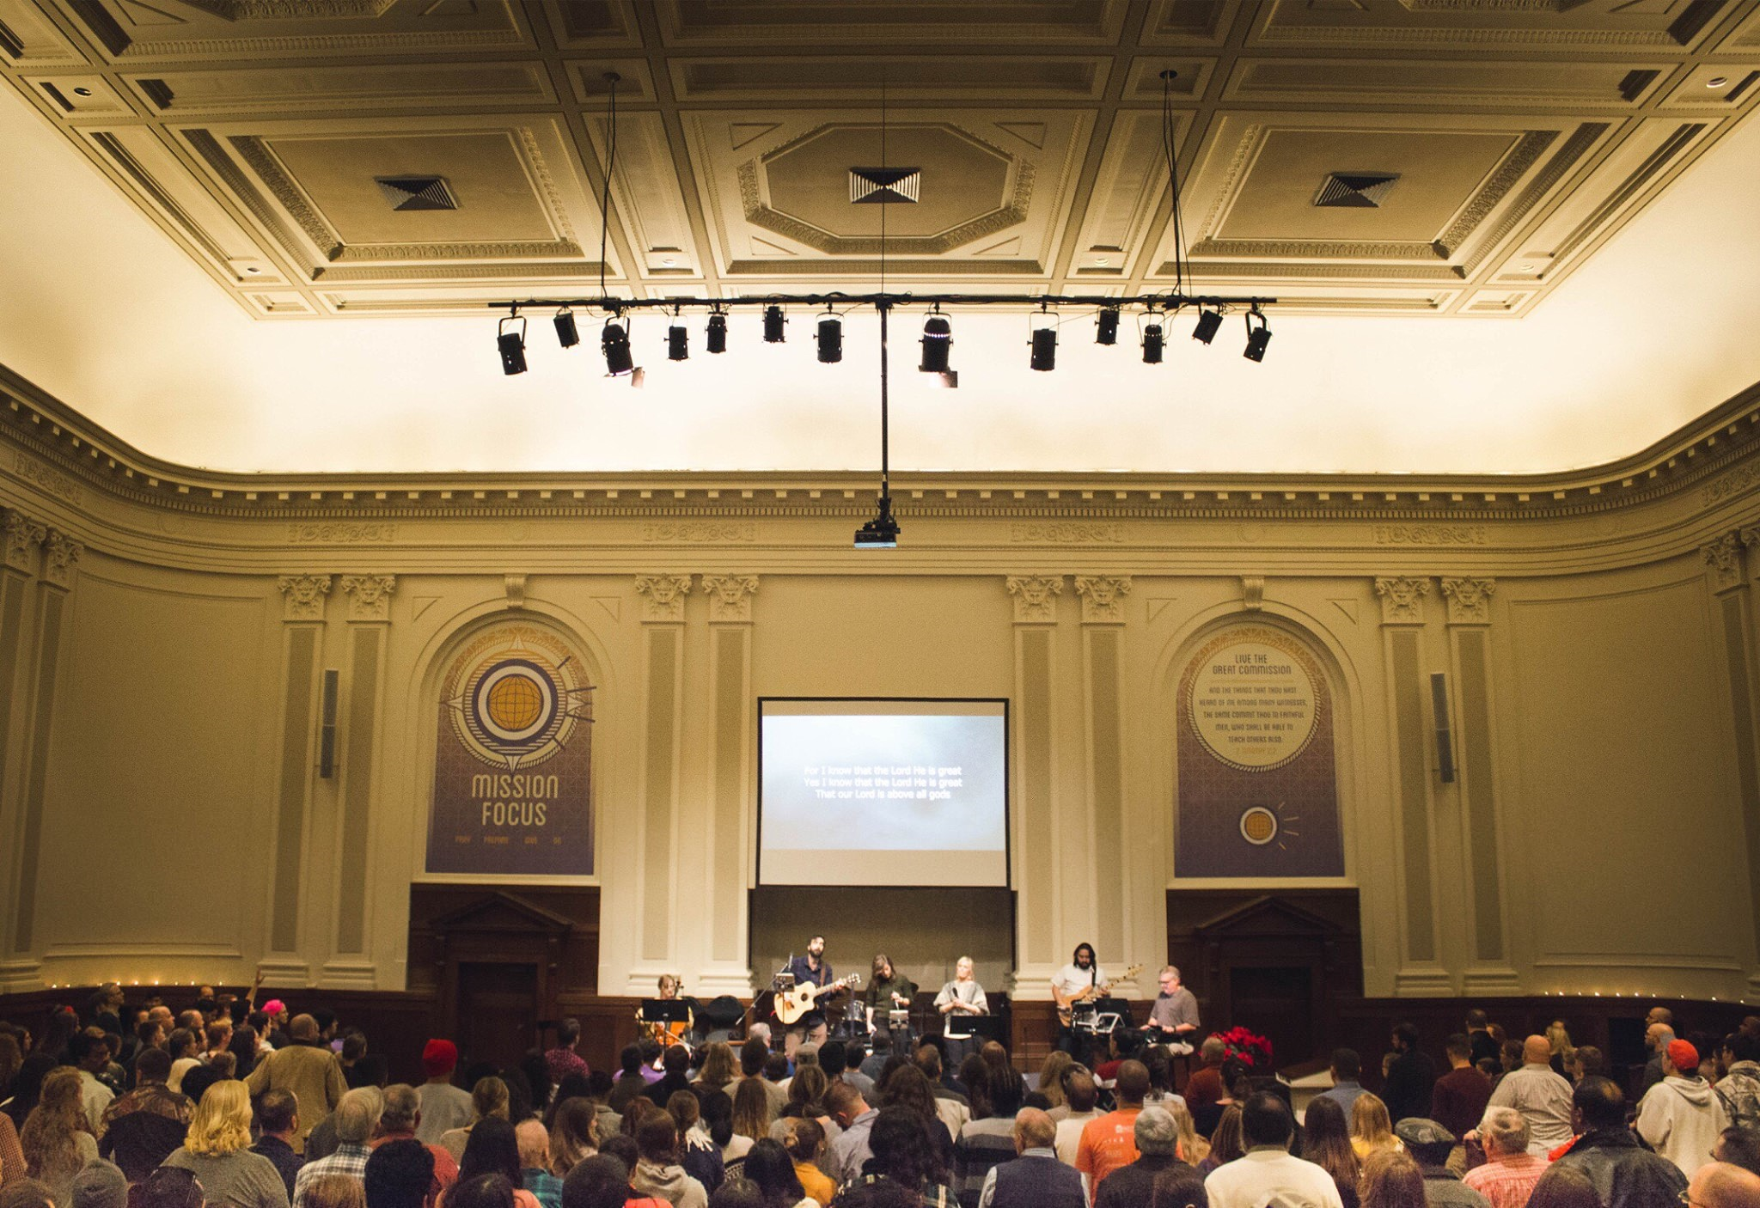
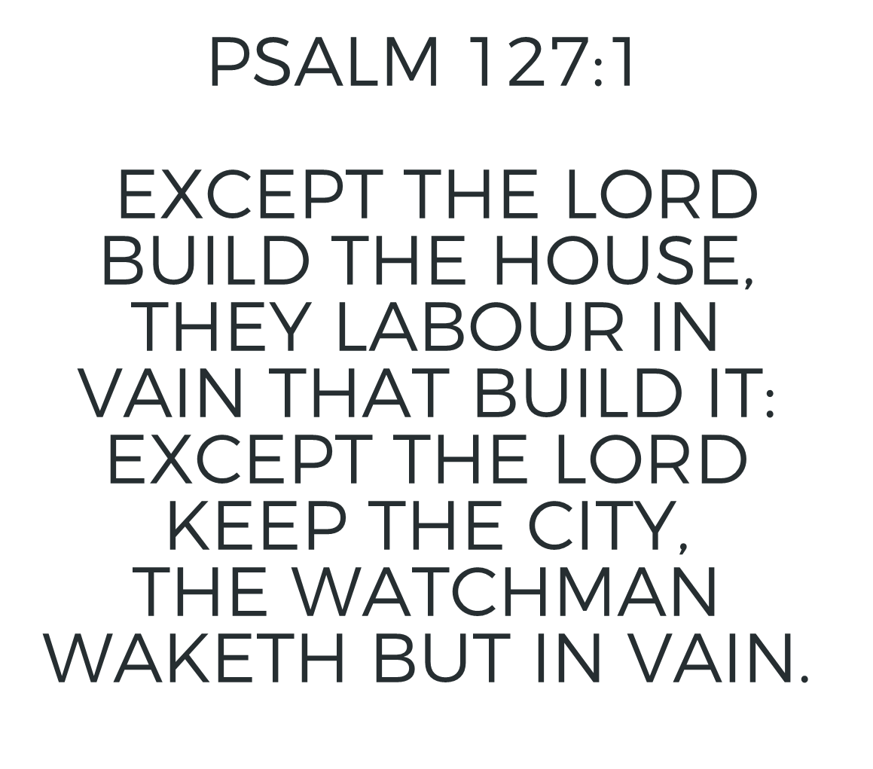

Slide 5
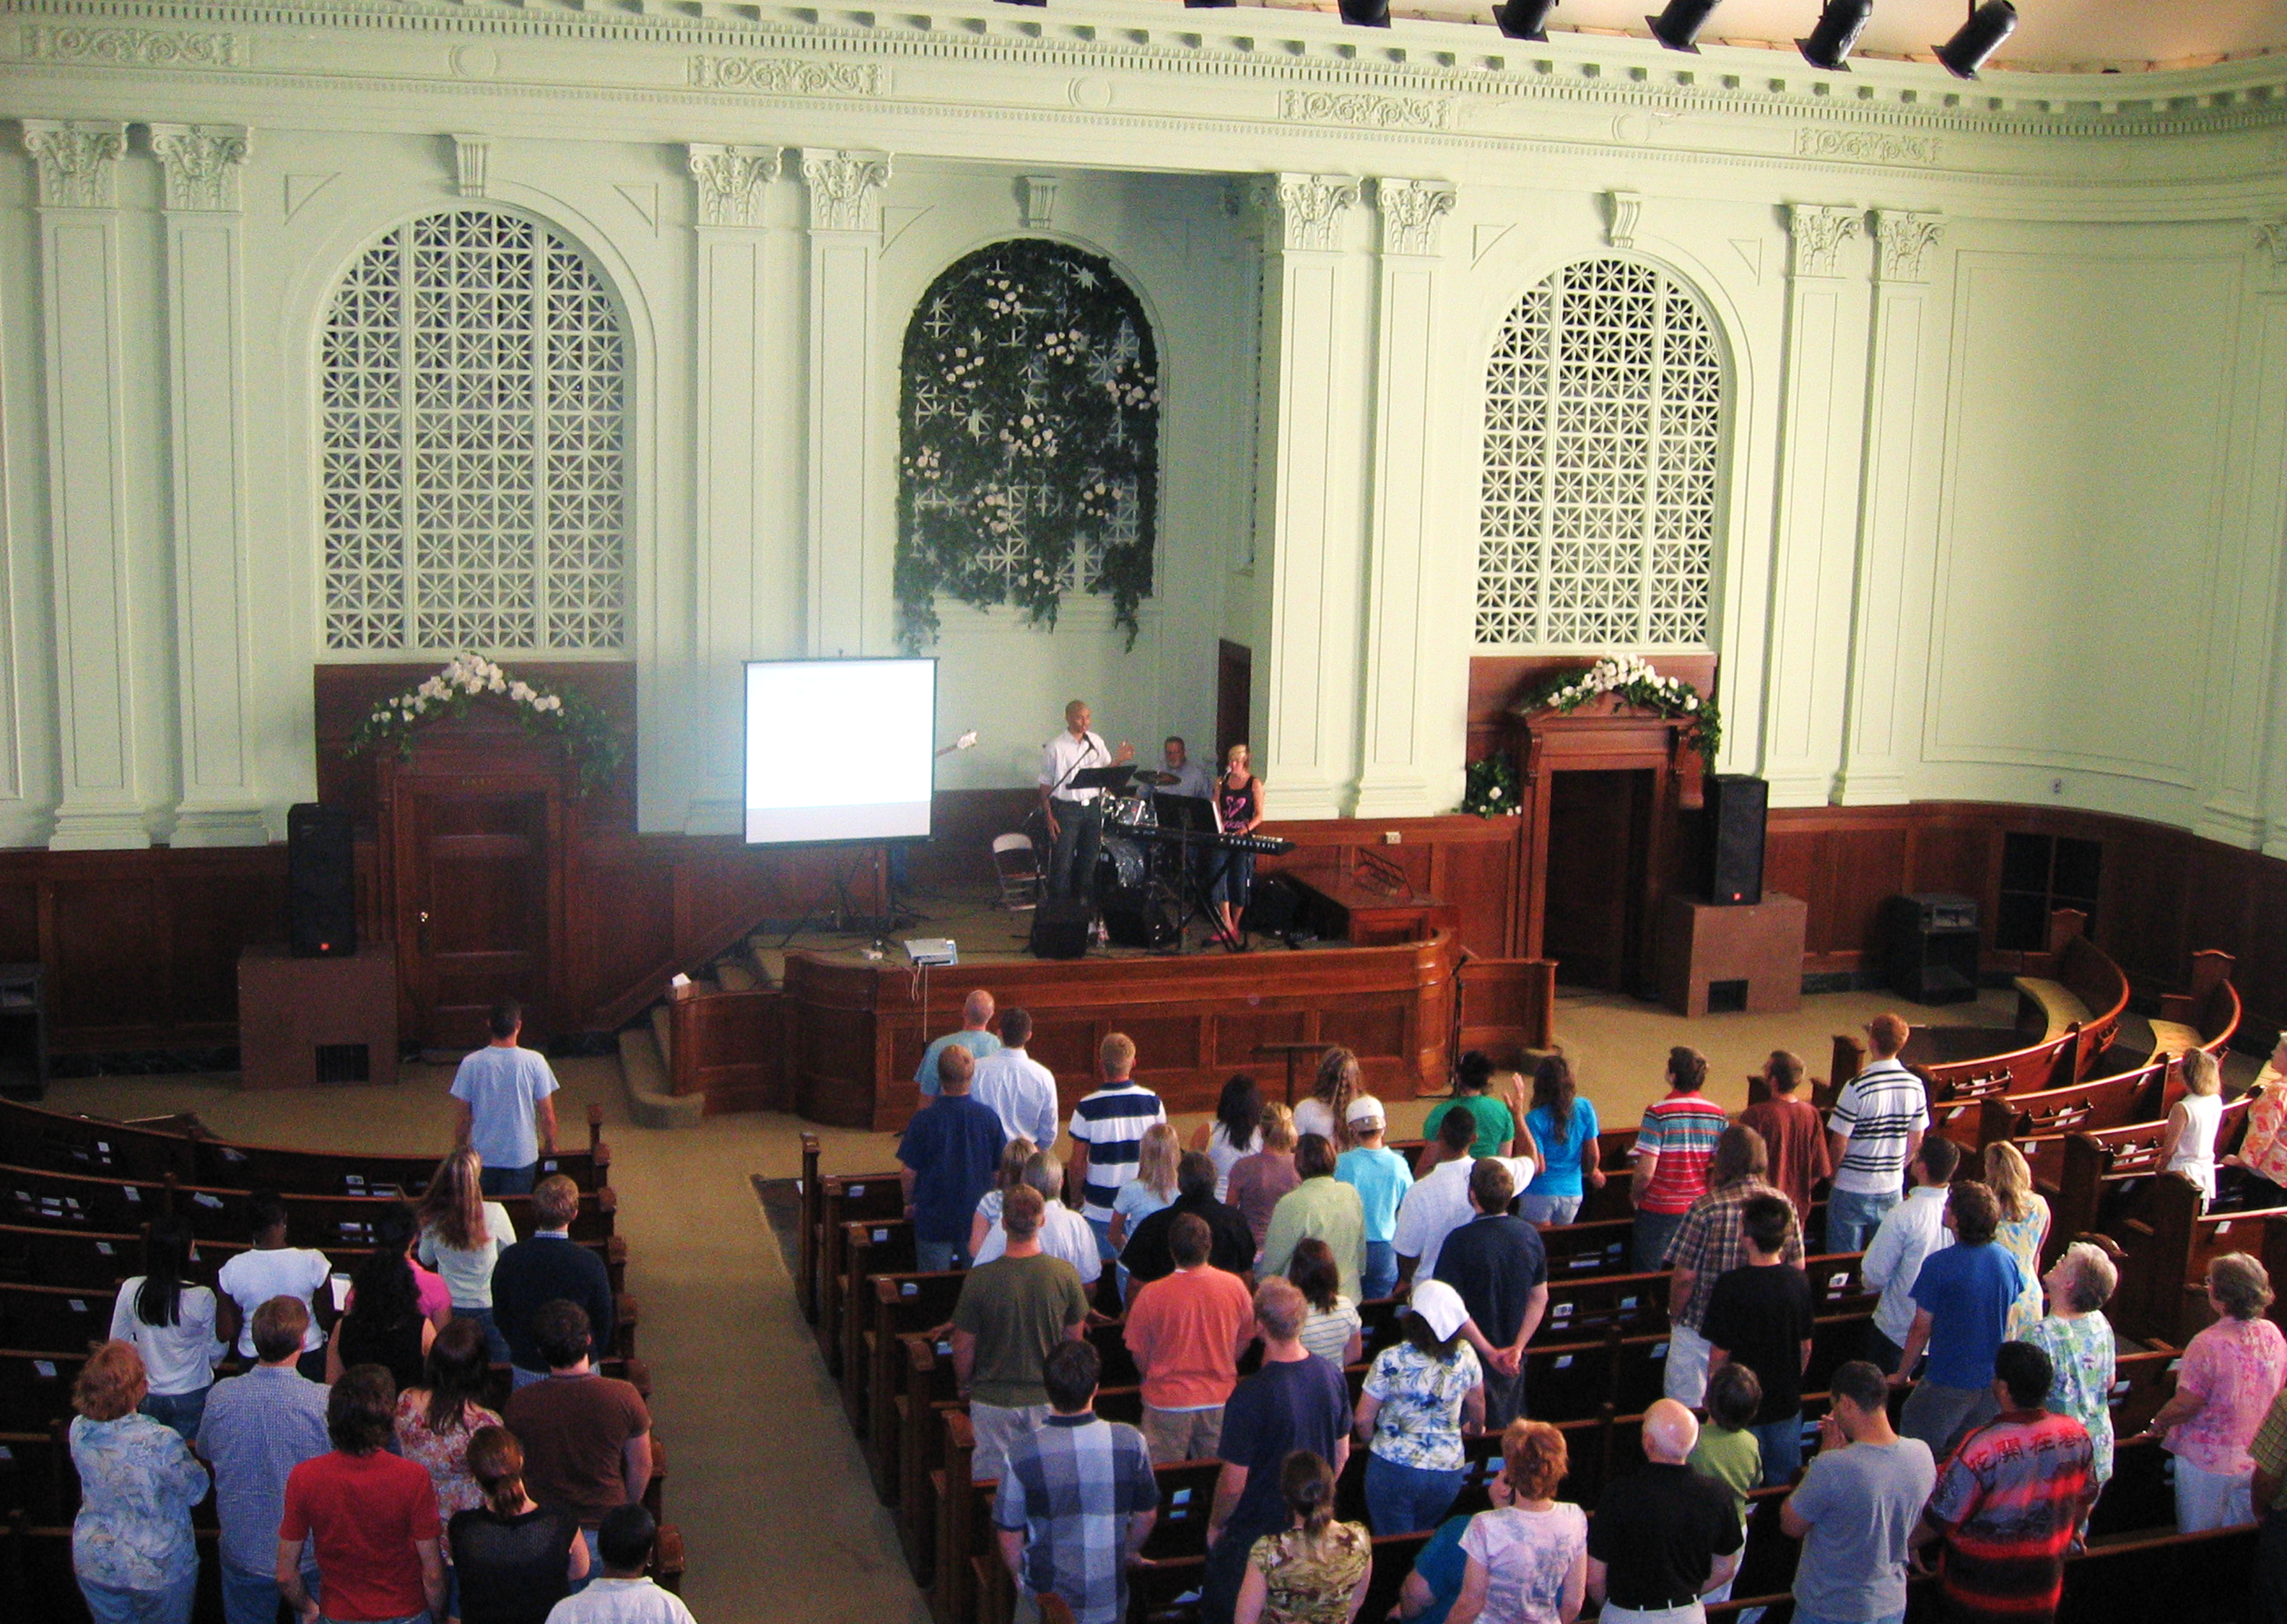
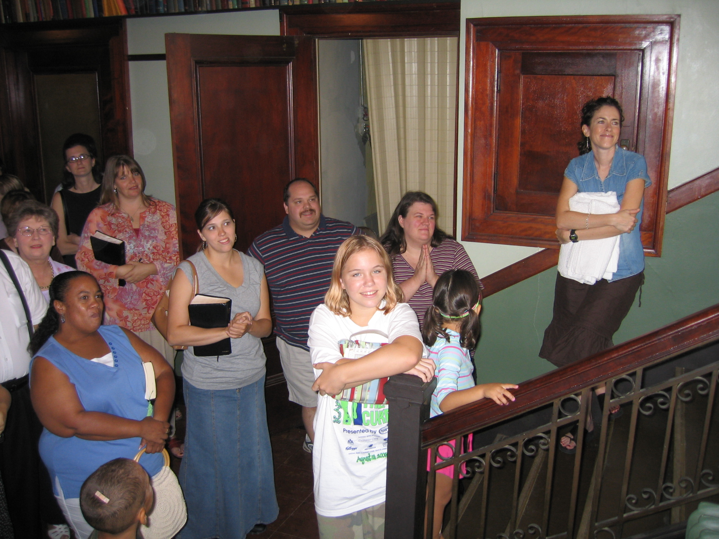
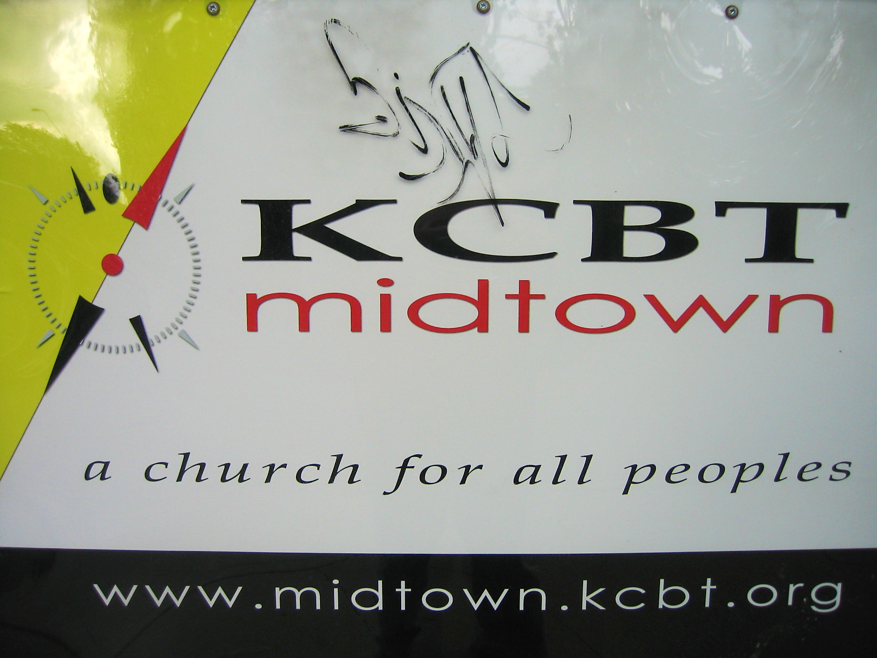

Slide 6
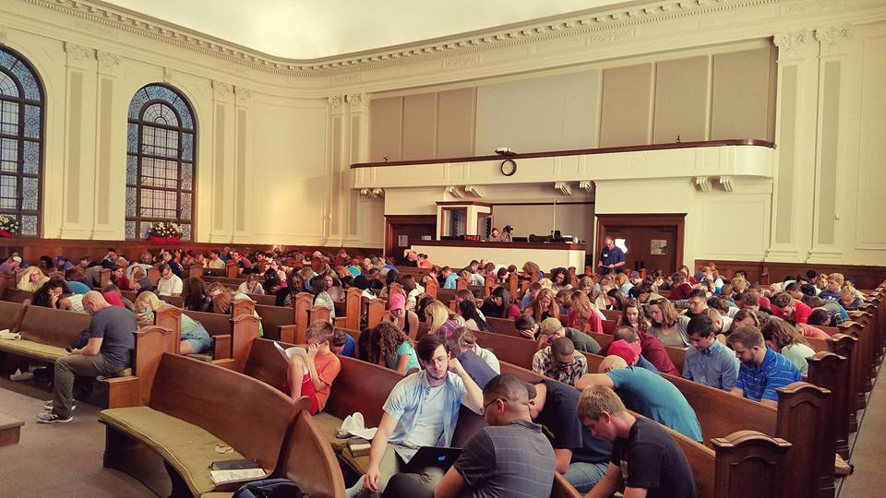

Slide 7
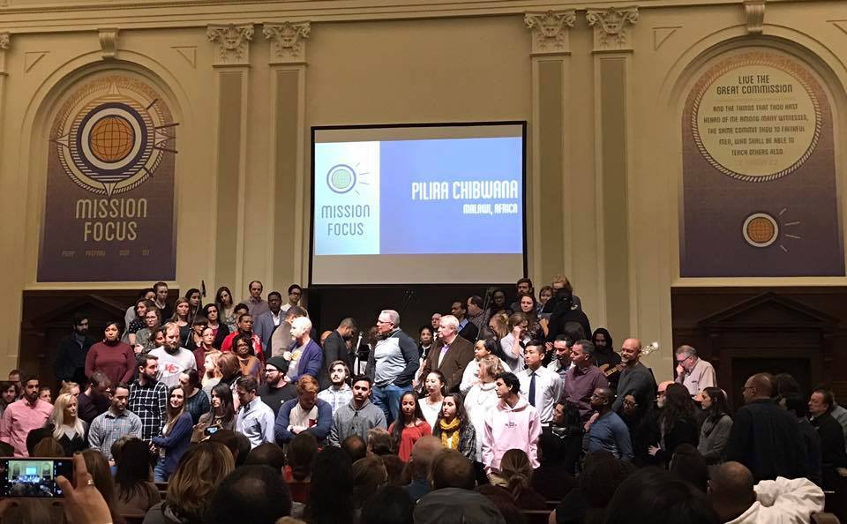

Slide 8
2016-2017 spending (review)
3
Inreach
1
24.23%
Building
Kidtown, Fellowships, benevolence, etc…
9.89%
Facility expenses,
new construction, etc…
Total
budget
1.07M
4
Outreach
Kingdom spending, missions, community outside MBT
2
32.50%
33.38%
Admin
Salaries, office supplies, Copier, etc…
Designated Savings
99.76K

Slide 9

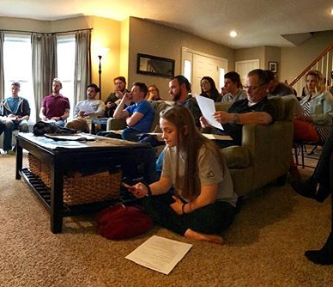
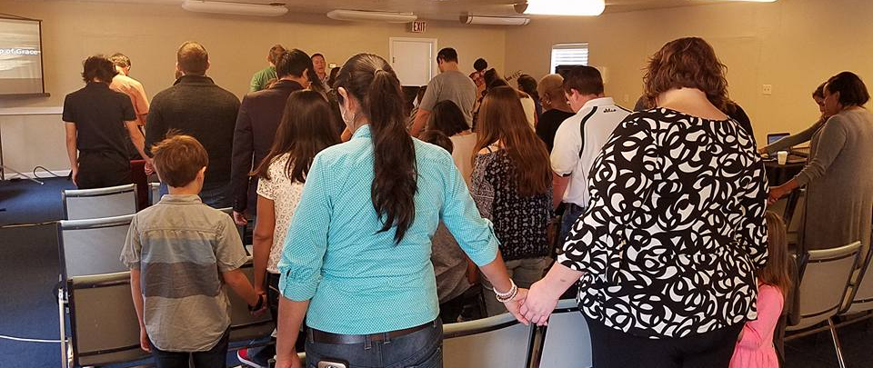
Investment MBT family of Churches
Sent $75k per year with MBT members going to start two new church plants

Slide 10
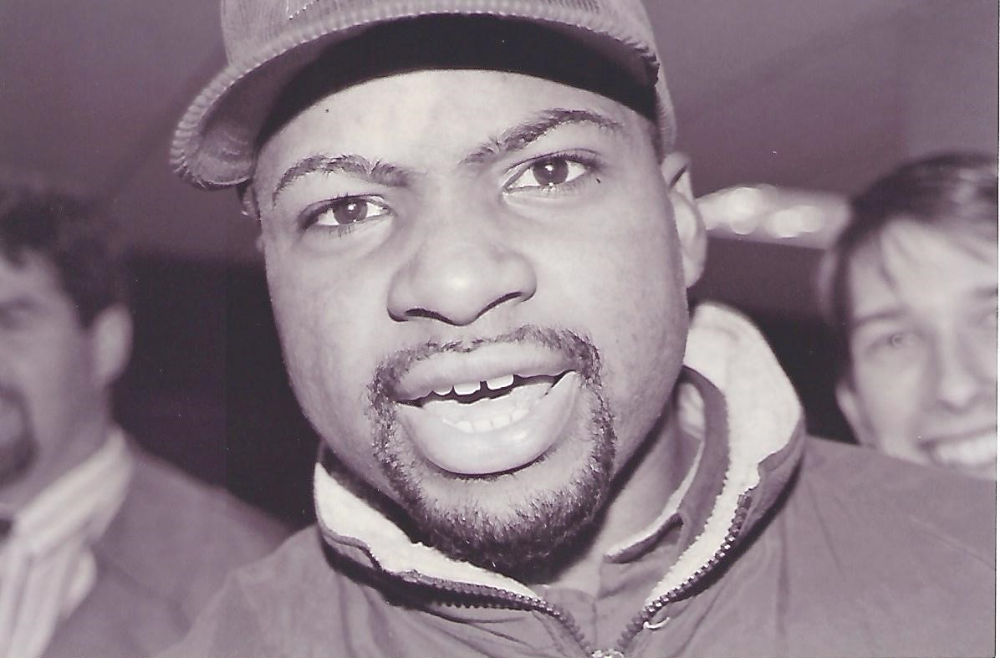
Pastor Kenny Morgan full time – June 2017
Notes:
Jeff GRASHER ordained – Housing Allowance - 2017

Slide 11
2017-18 spending
3
Inreach
1
17.88%
Building
Kidtown, Fellowships, benevolence, etc…
10.75%
Facility expenses,
new construction, etc…
Total
budget
1.422M
4
Outreach
Kingdom spending, missions, community outside MBT
2
32.53%
38.38%
Admin
Salaries, office supplies, Copier, etc…
Designated Savings
154.6K

Slide 12
MBT Total
Mortgage
remaining?
303K
Purchase price
Church $500,000
House $140,000

Slide 14
Attendance
Up 33%
After 2
church plants

Slide 15
Regular Givers
170

Slide 16
Regular servers
225

Slide 17

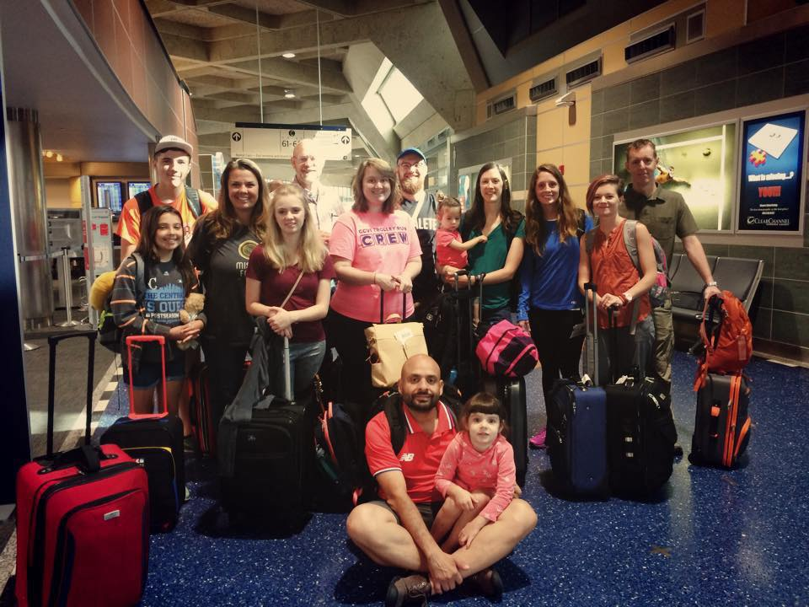
Growing in
ministry
50
LFBI
D2
60
D1
76 pairs

Slide 19
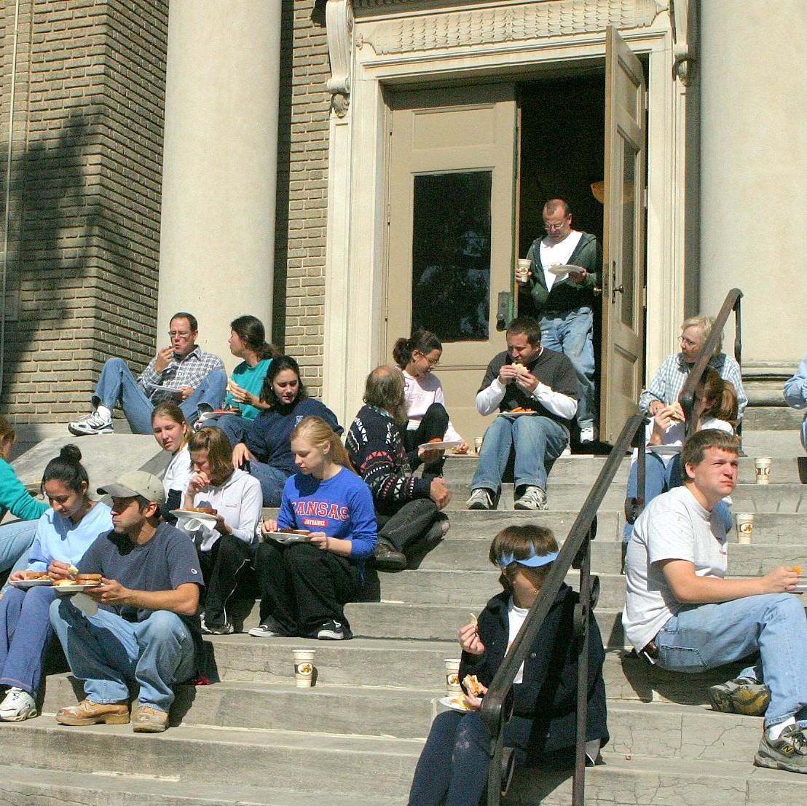
Ministry Fair
Attend weekly worship services.
Plug into a Sunday Fellowship.
Join a small group Bible Study.
Find a place to regularly serve.
Hospitality Team
Cafe’ / Kitchen
KidTown
Security
Worship
Audio / Video / Media

Slide 20
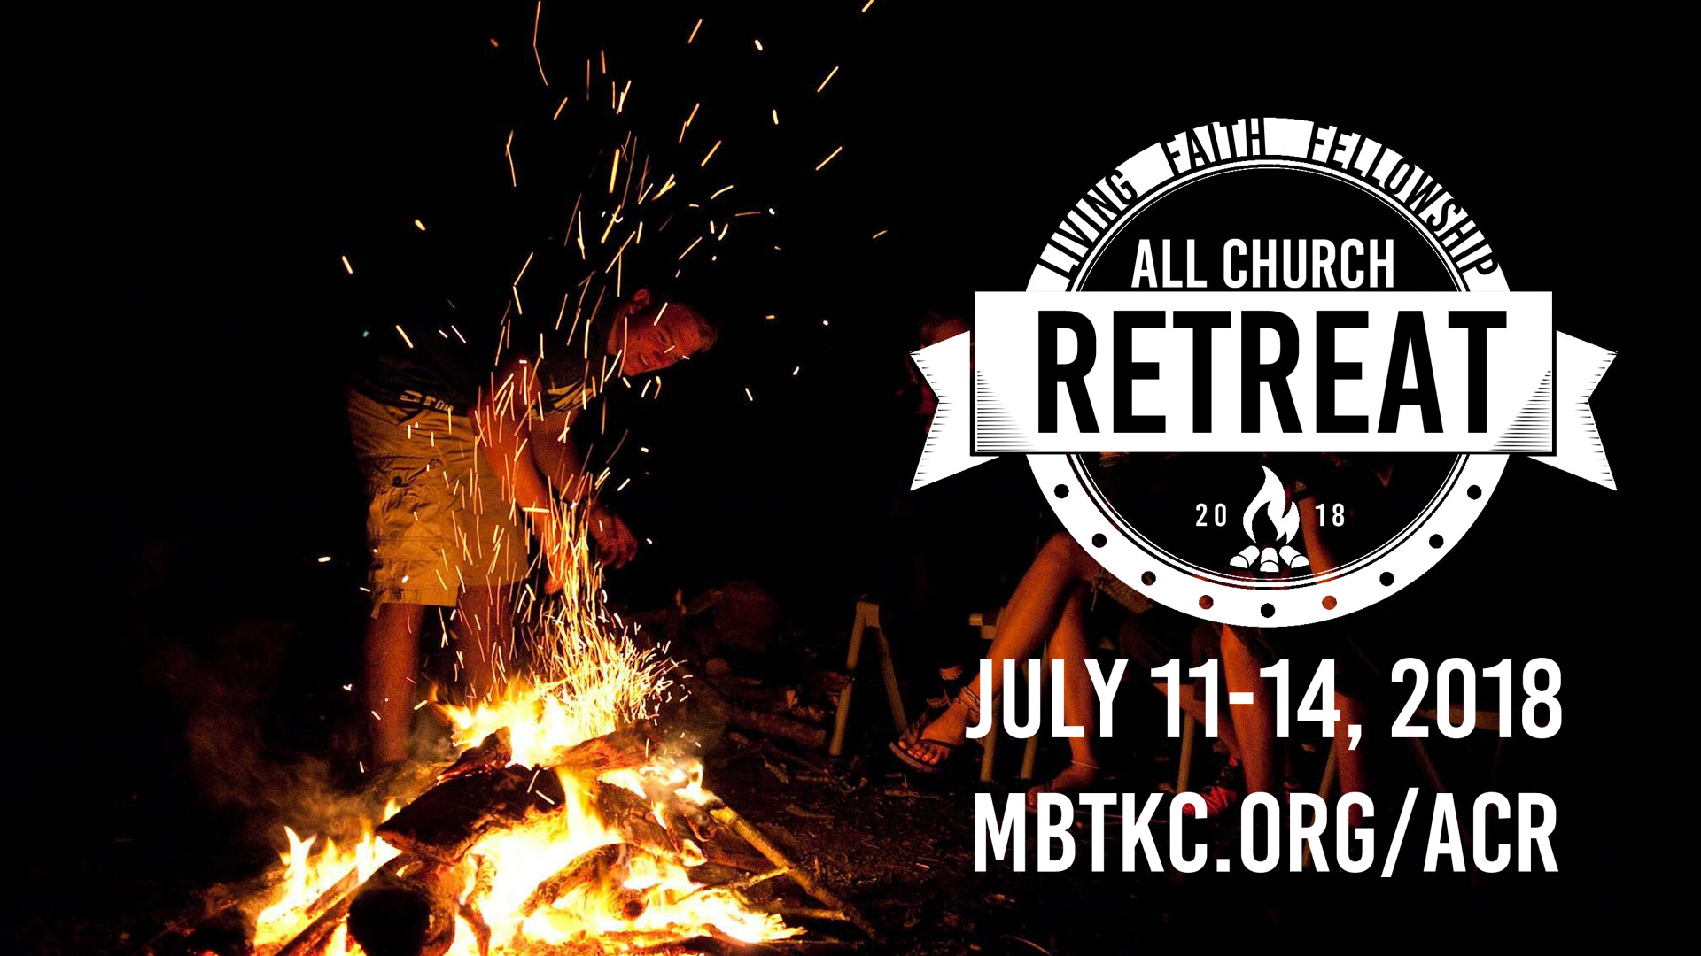

Slide 21
0
Vision
Update
2
8
1

